Slide 1
Installation and Git

Slide 2
Outline
Packages:
Anaconda (+Python)
https://www.anaconda.com/distribution/#download-section
https://docs.conda.io/projects/conda/en/4.6.0/_downloads/52a95608c49671267e40c689e0bc00ca/conda-cheatsheet.pdf
Notepad++
https://notepad-plus-plus.org/
Torch
https://pytorch.org/get-started/locally/
Scikit Learn
conda install scikit-learn
Git
https://git-scm.com/book/en/v2/Getting-Started-Installing-Git

Slide 3
Anaconda and Python
Anaconda is an environment management tool
Includes Python as a bundle
We strongly recommend using an environment manager, even if not anaconda
Manages dependencies and packages, especially helpful if some packages are mutually exclusive

Slide 4
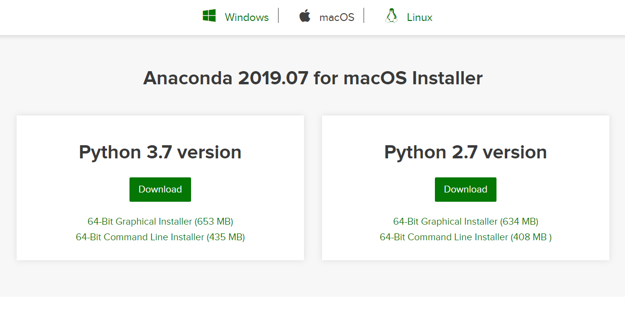

Slide 5
Notepad++
Near universal text editing software
Works for everything from Assembly to HTML
Fast, lightweight and effective
IMPORTANT: Change tab spacing

Slide 6
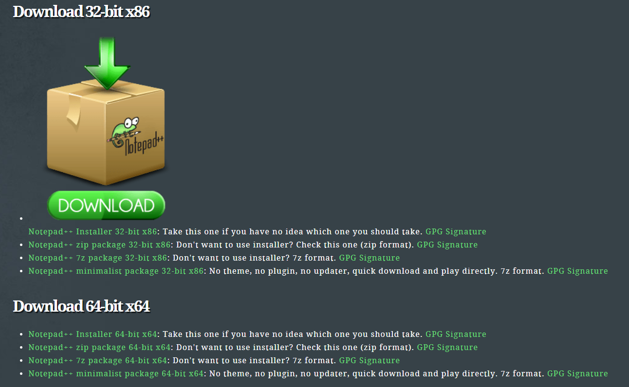

Slide 7
PyTorch
Set of tools for making and testing neural networks in Python
Built-in layers, activation functions, loss functions, and other methods simplify model development
Allows integration and generalization of custom modules
Can be used without GPU, but provides built-in, easy to use optimizations for GPU

Slide 8
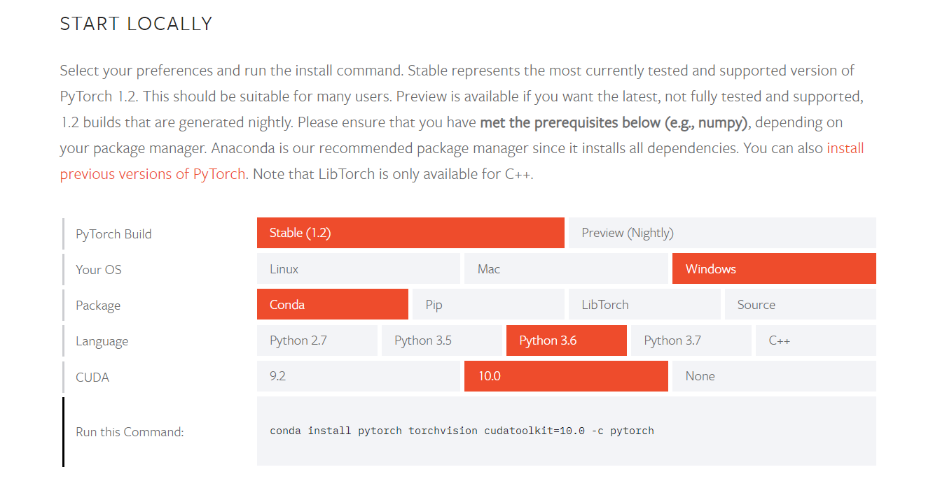

Slide 9
Scikit-learn
All-in-one package for data-science
Provides many tools for data-mining and analysis
Includes many of the most popular algorithms for regression, clustering etc.
Pipeline-oriented (pre-process=>model=>model-refinement=>deployment)

Slide 10
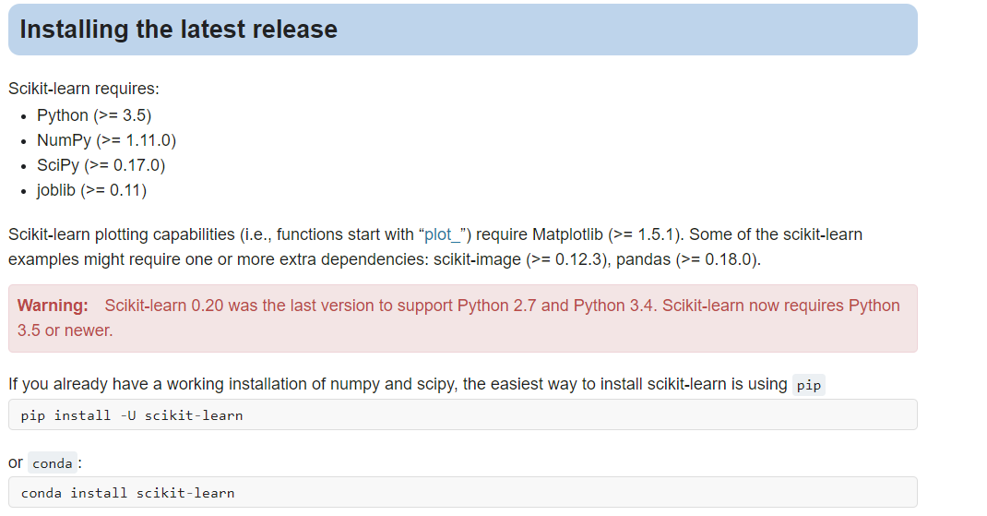

Slide 11
Git
Incredibly widespread project-management and versioning software
Uses “branching” philosophy
Allows for decentralized repositories
Offers synchronization via “remote” repositories

Slide 12
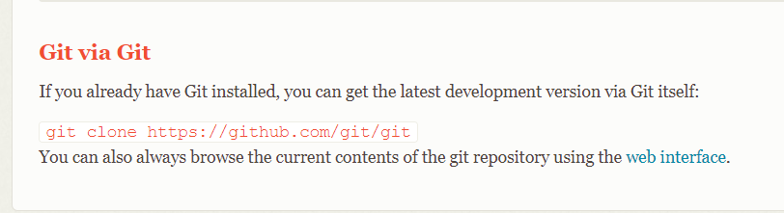

Slide 13
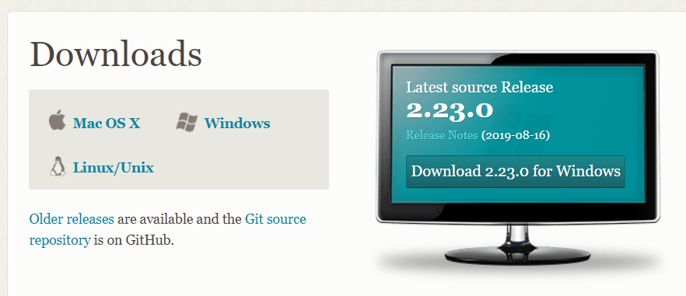

Slide 14
Jupyter
Wonderful software for making interactive code books
Allows for flexible and customizable user interfaces for a better code developing experience
Widely used in the data-science realm for reproducibility

Slide 15
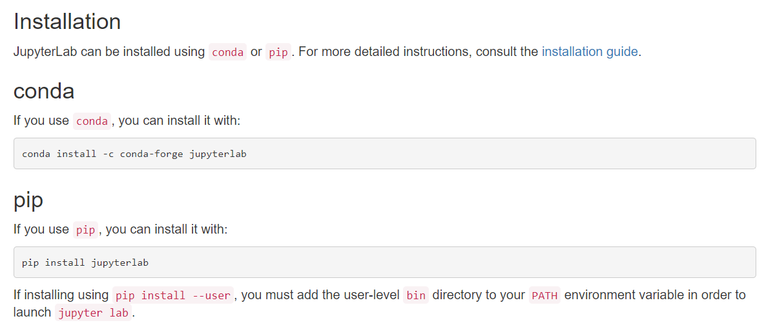

Slide 16
List of Cheat Sheets:
Anaconda (+Python)
https://docs.conda.io/projects/conda/en/4.6.0/_downloads/52a95608c49671267e40c689e0bc00ca/conda-cheatsheet.pdf
Notepad++
http://www.cheat-sheets.org/saved-copy/Notepad++_Cheat_Sheet.pdf
Torch
https://pytorch.org/tutorials/beginner/ptcheat.html
Scikit Learn*
https://scikit-learn.org/stable/tutorial/machine_learning_map/index.html
Git
https://github.github.com/training-kit/downloads/github-git-cheat-sheet.pdf

Slide 17
Git Hands On With Git
https://learngitbranching.js.org/?locale=en_US

